Slide 1
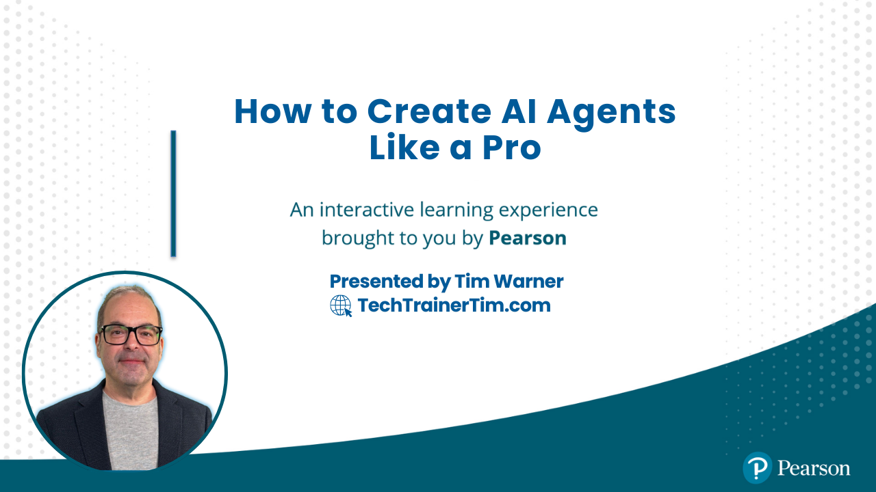
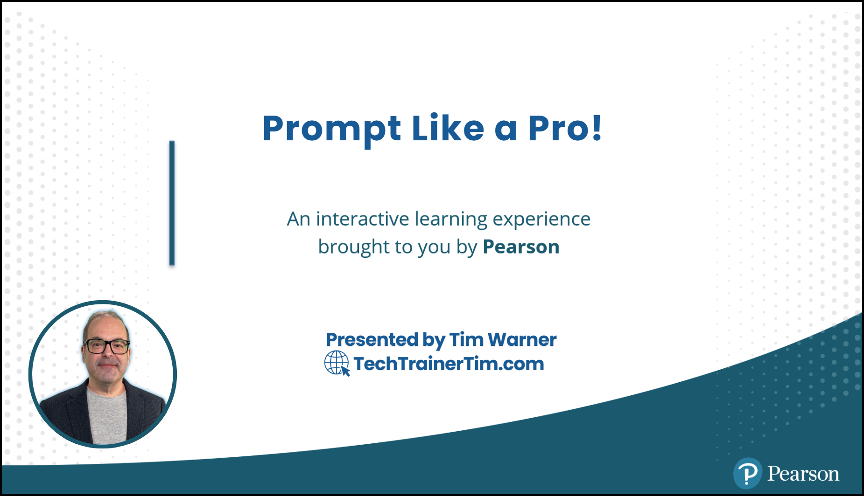





GitHub Copilot for Developers
Tim Warner
Principal Author, Pluralsight
timw.info | azureopenai.blog

Slide 2
Course Flow (Central Time)
09:00 AM Segment 1 [Introduction to Agentic AI]
10:00 AM Segment 2 [Contoso Customer Service Agent]
11:00 AM Segment 3 [Contoso Onboarding Assistant]
12:00 PM Segment 4 [Contoso Document Routing Agent]
01:00 PM Finish

Slide 3

Session Materials
github.com/timothywarner-org/agents-pro

Slide 4
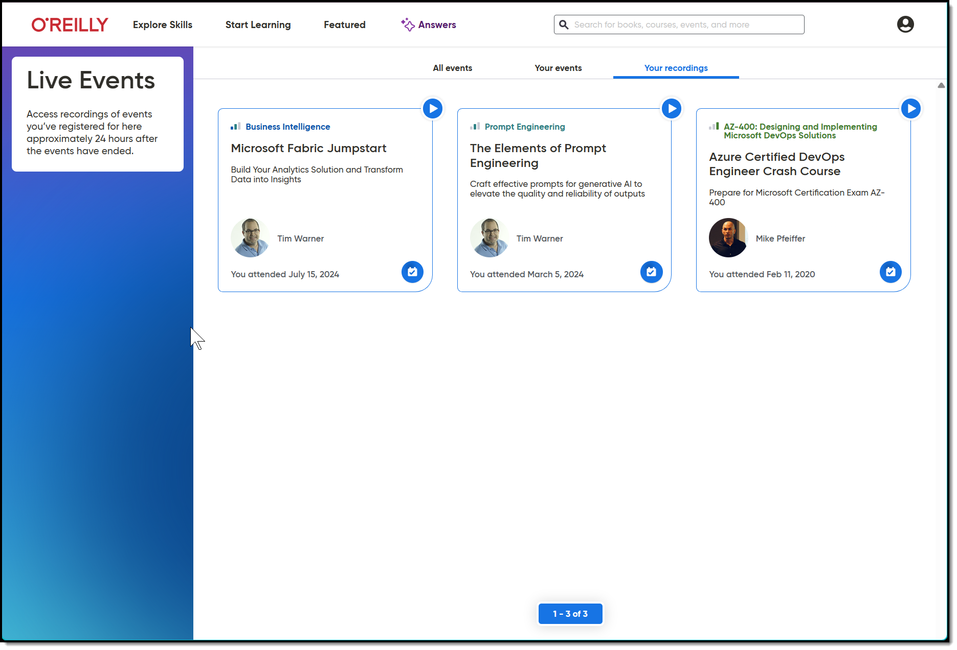
Session Recording + Badge

Slide 5
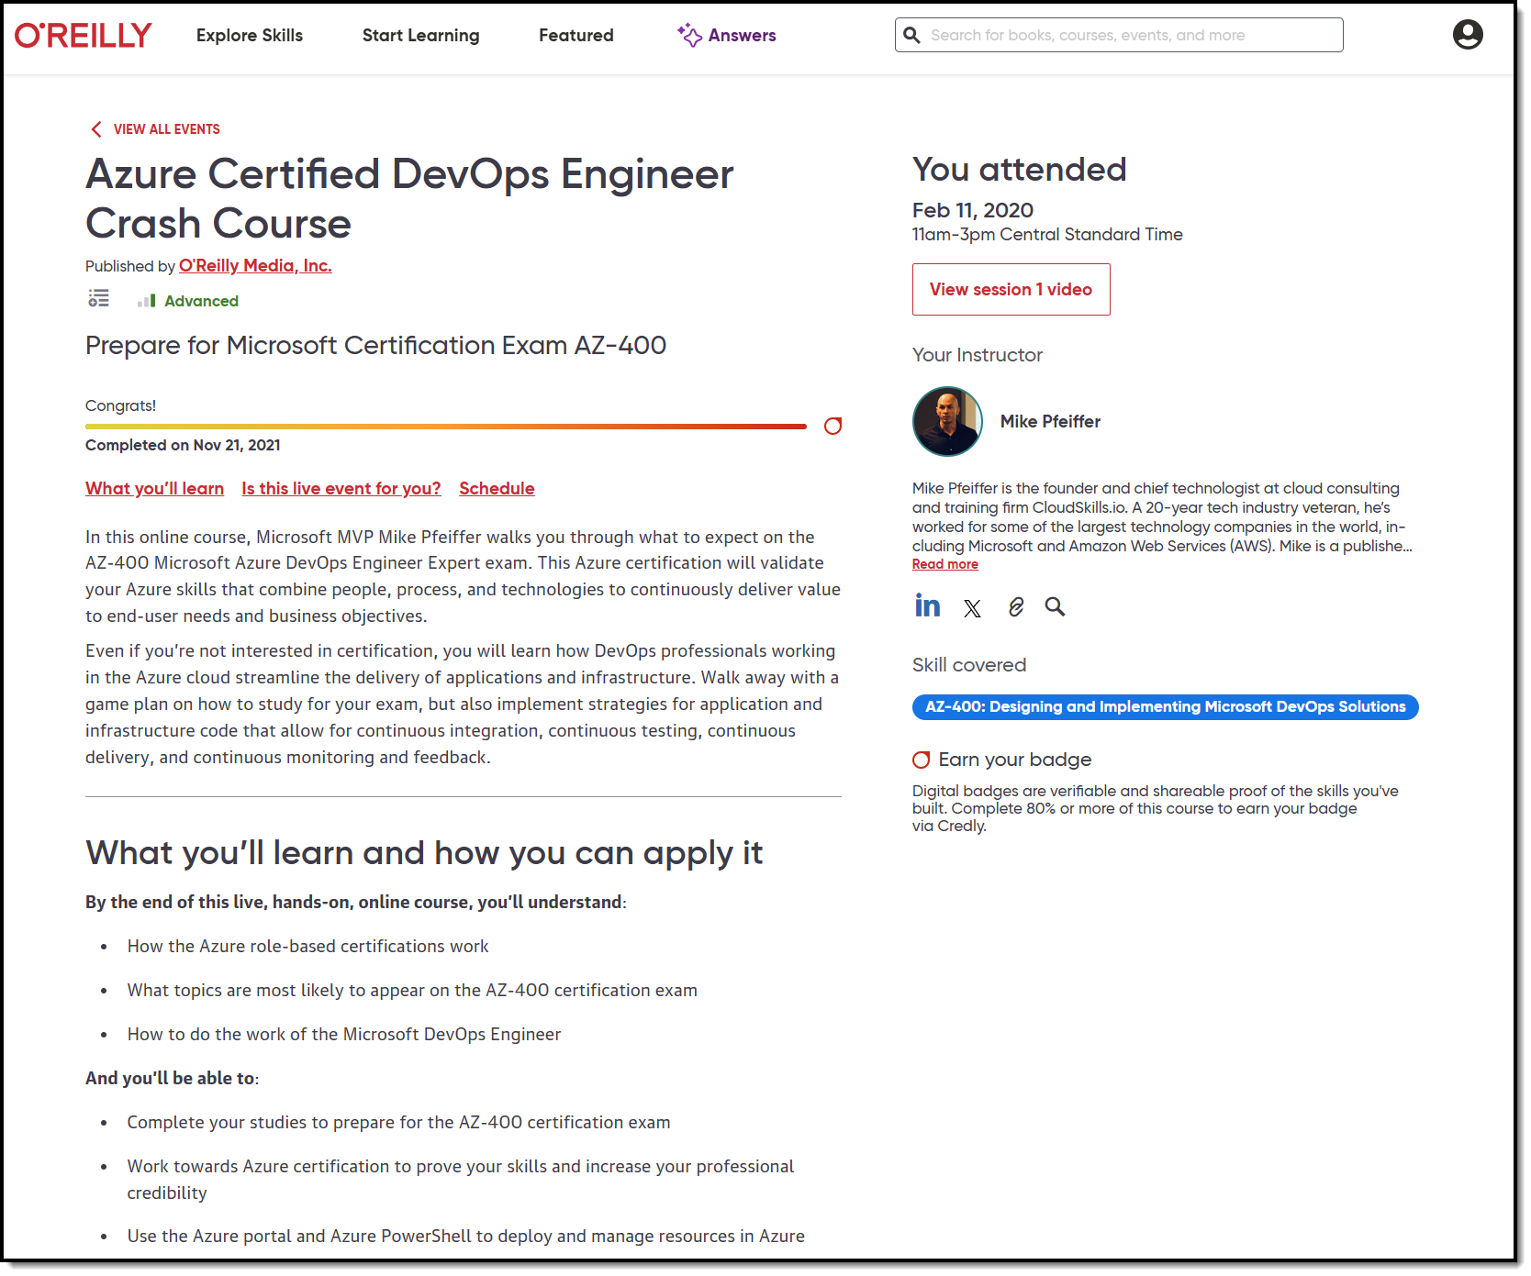
Session Recording + Badge

Slide 6
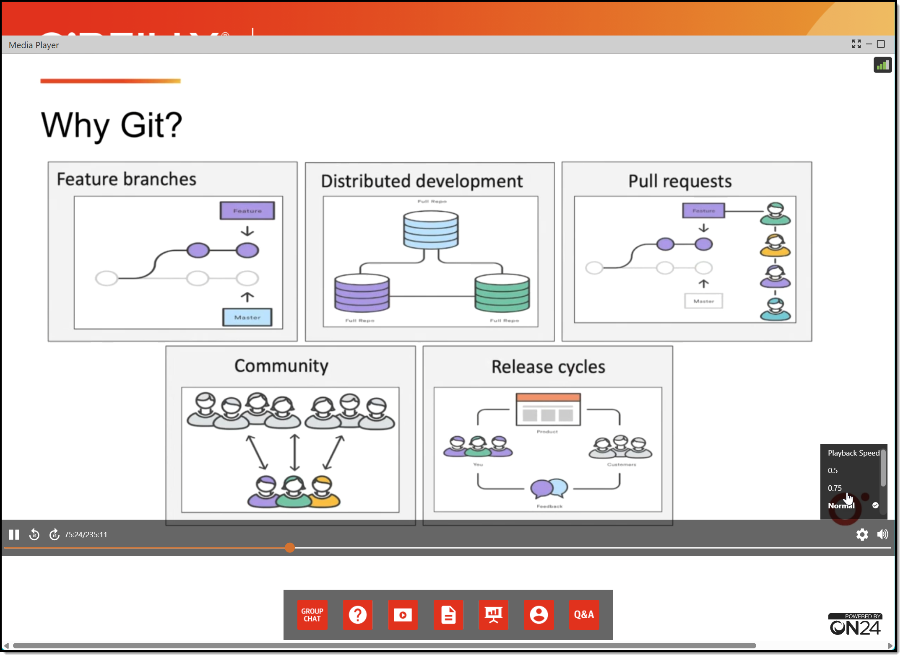
Session Recording + Badge

Slide 7
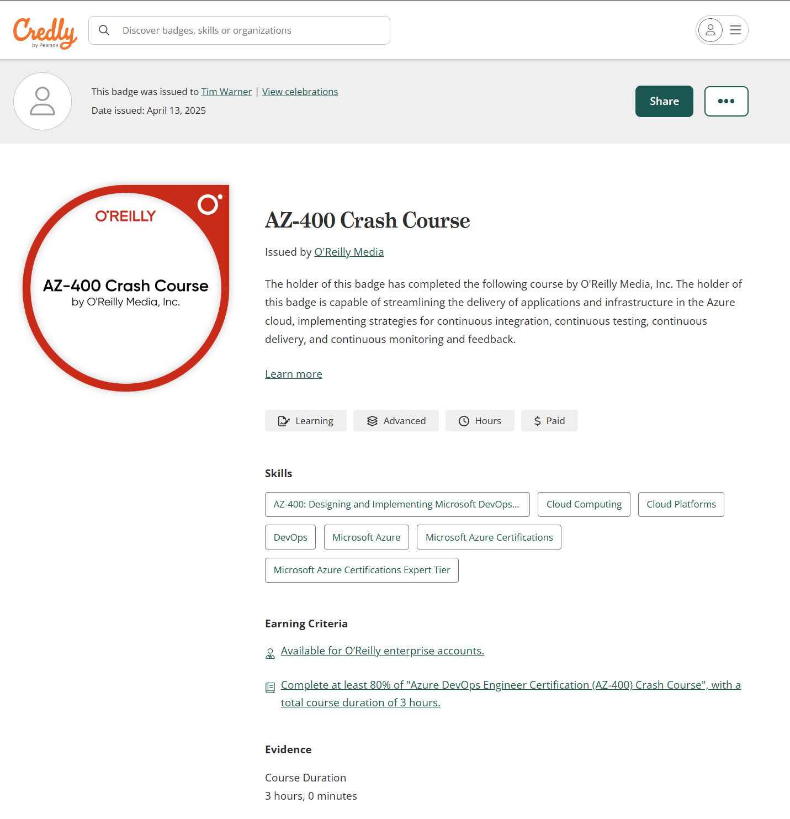
Session Recording + Badge

Slide 8
Oh, Before I Forget...
Please add your questions, comments, concerns, curiosities, etc. to the Q&A panel rather than the Group Chat. I don’t want to miss what you have to say and do want to answer your questions. Thanks muchly! -Tim

Slide 9

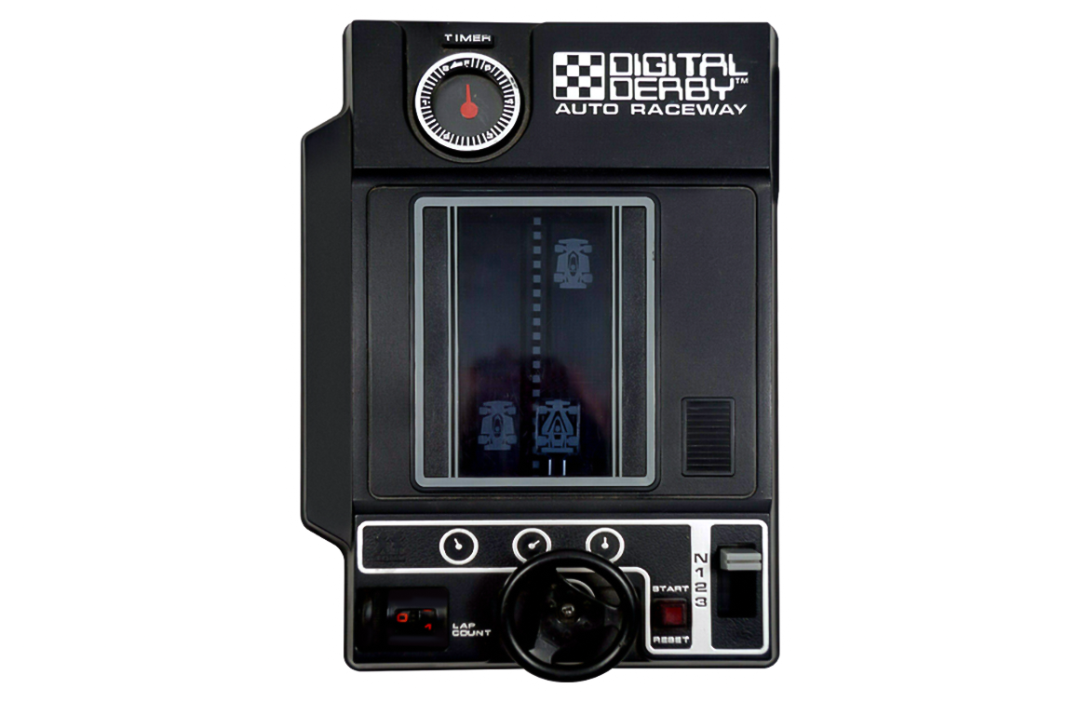

Keeping an LLM on task be like…

Slide 10
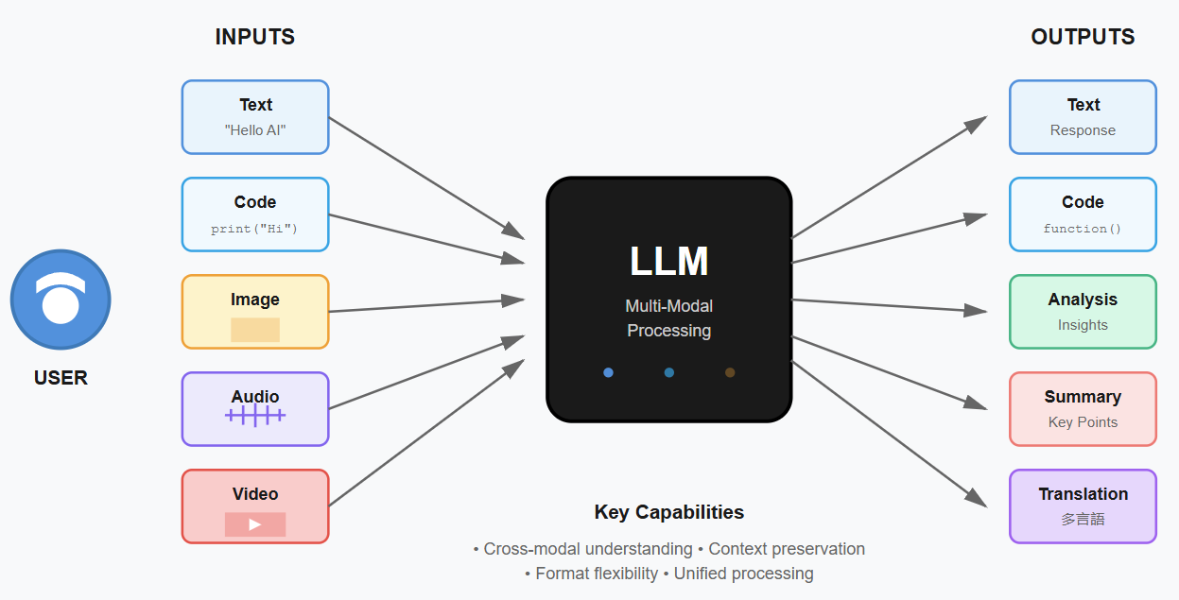
LLM Multi-Modal Processing
Notes:
Image credit: Tim + Claude AI

Slide 11
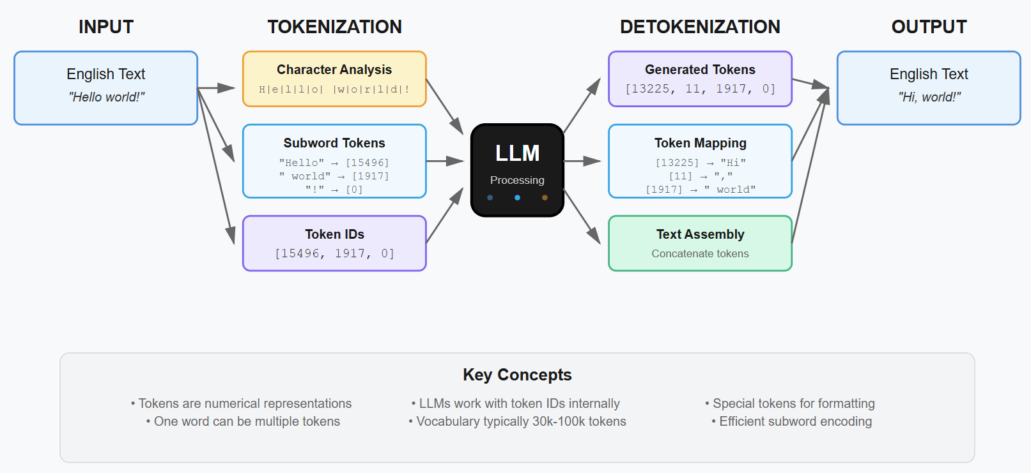
Tokenization Process in LLMs

Slide 12

Context Length

Slide 13
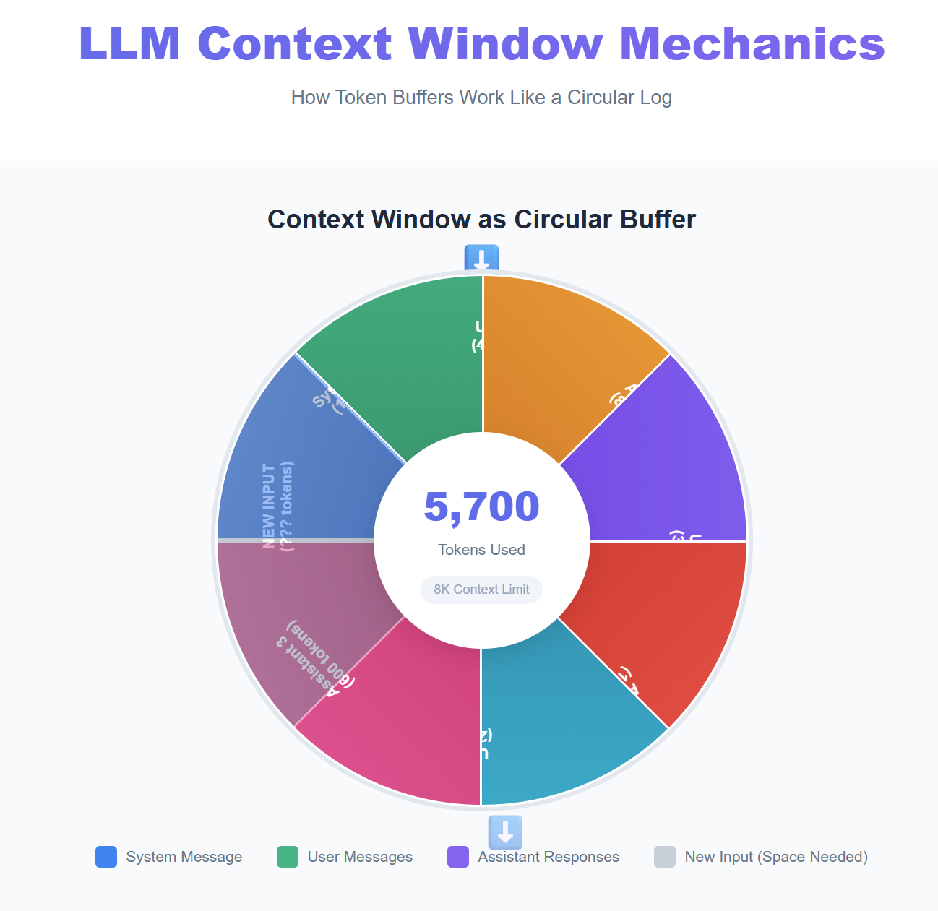
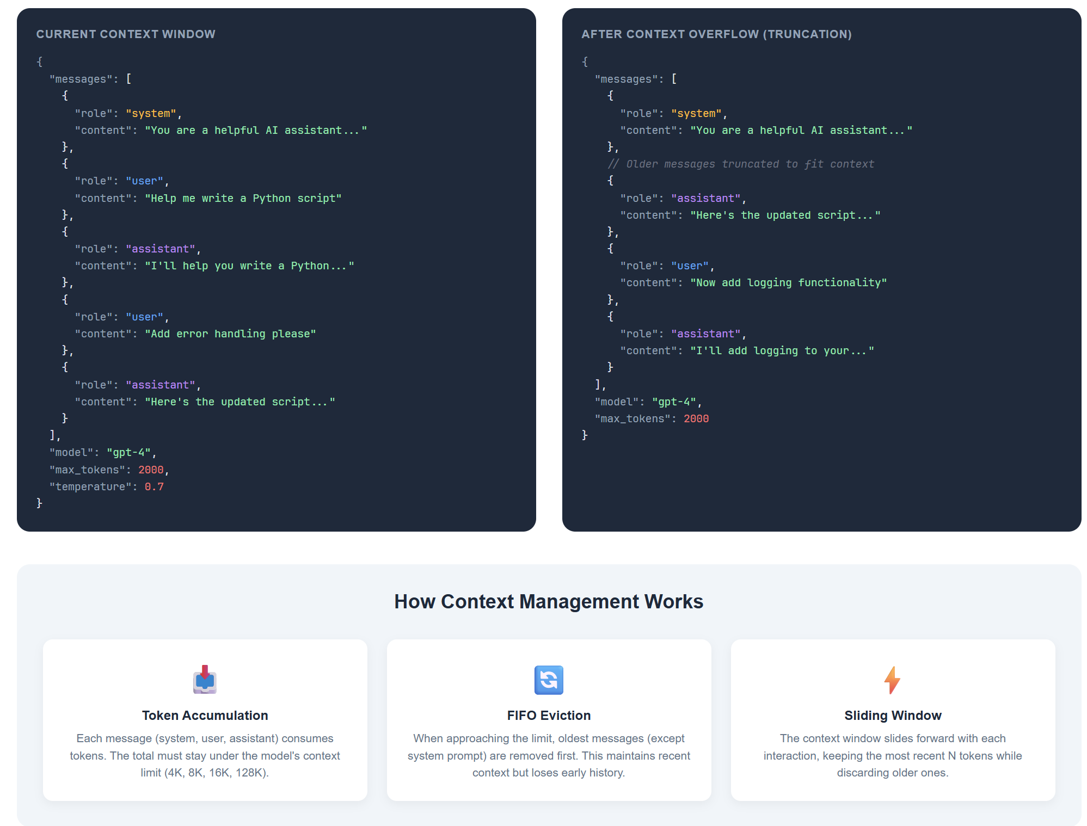

Slide 14
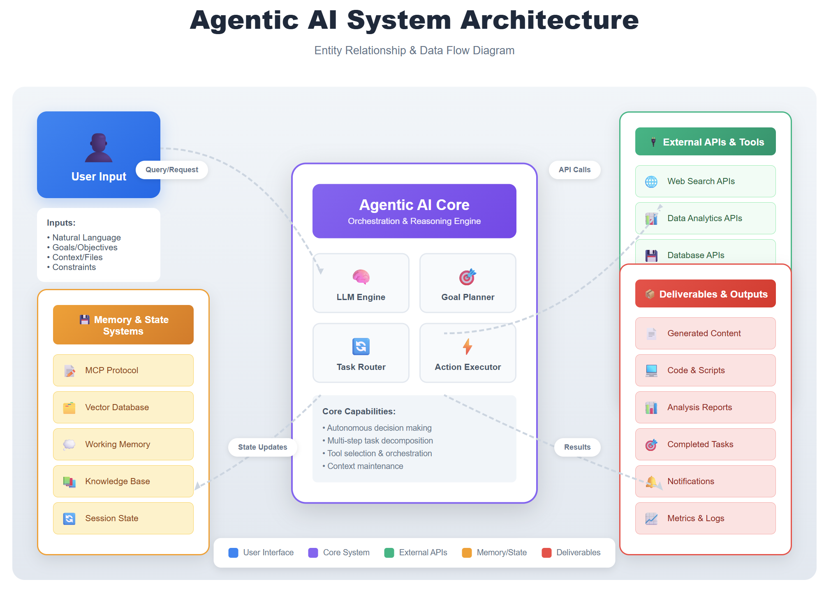

Slide 15
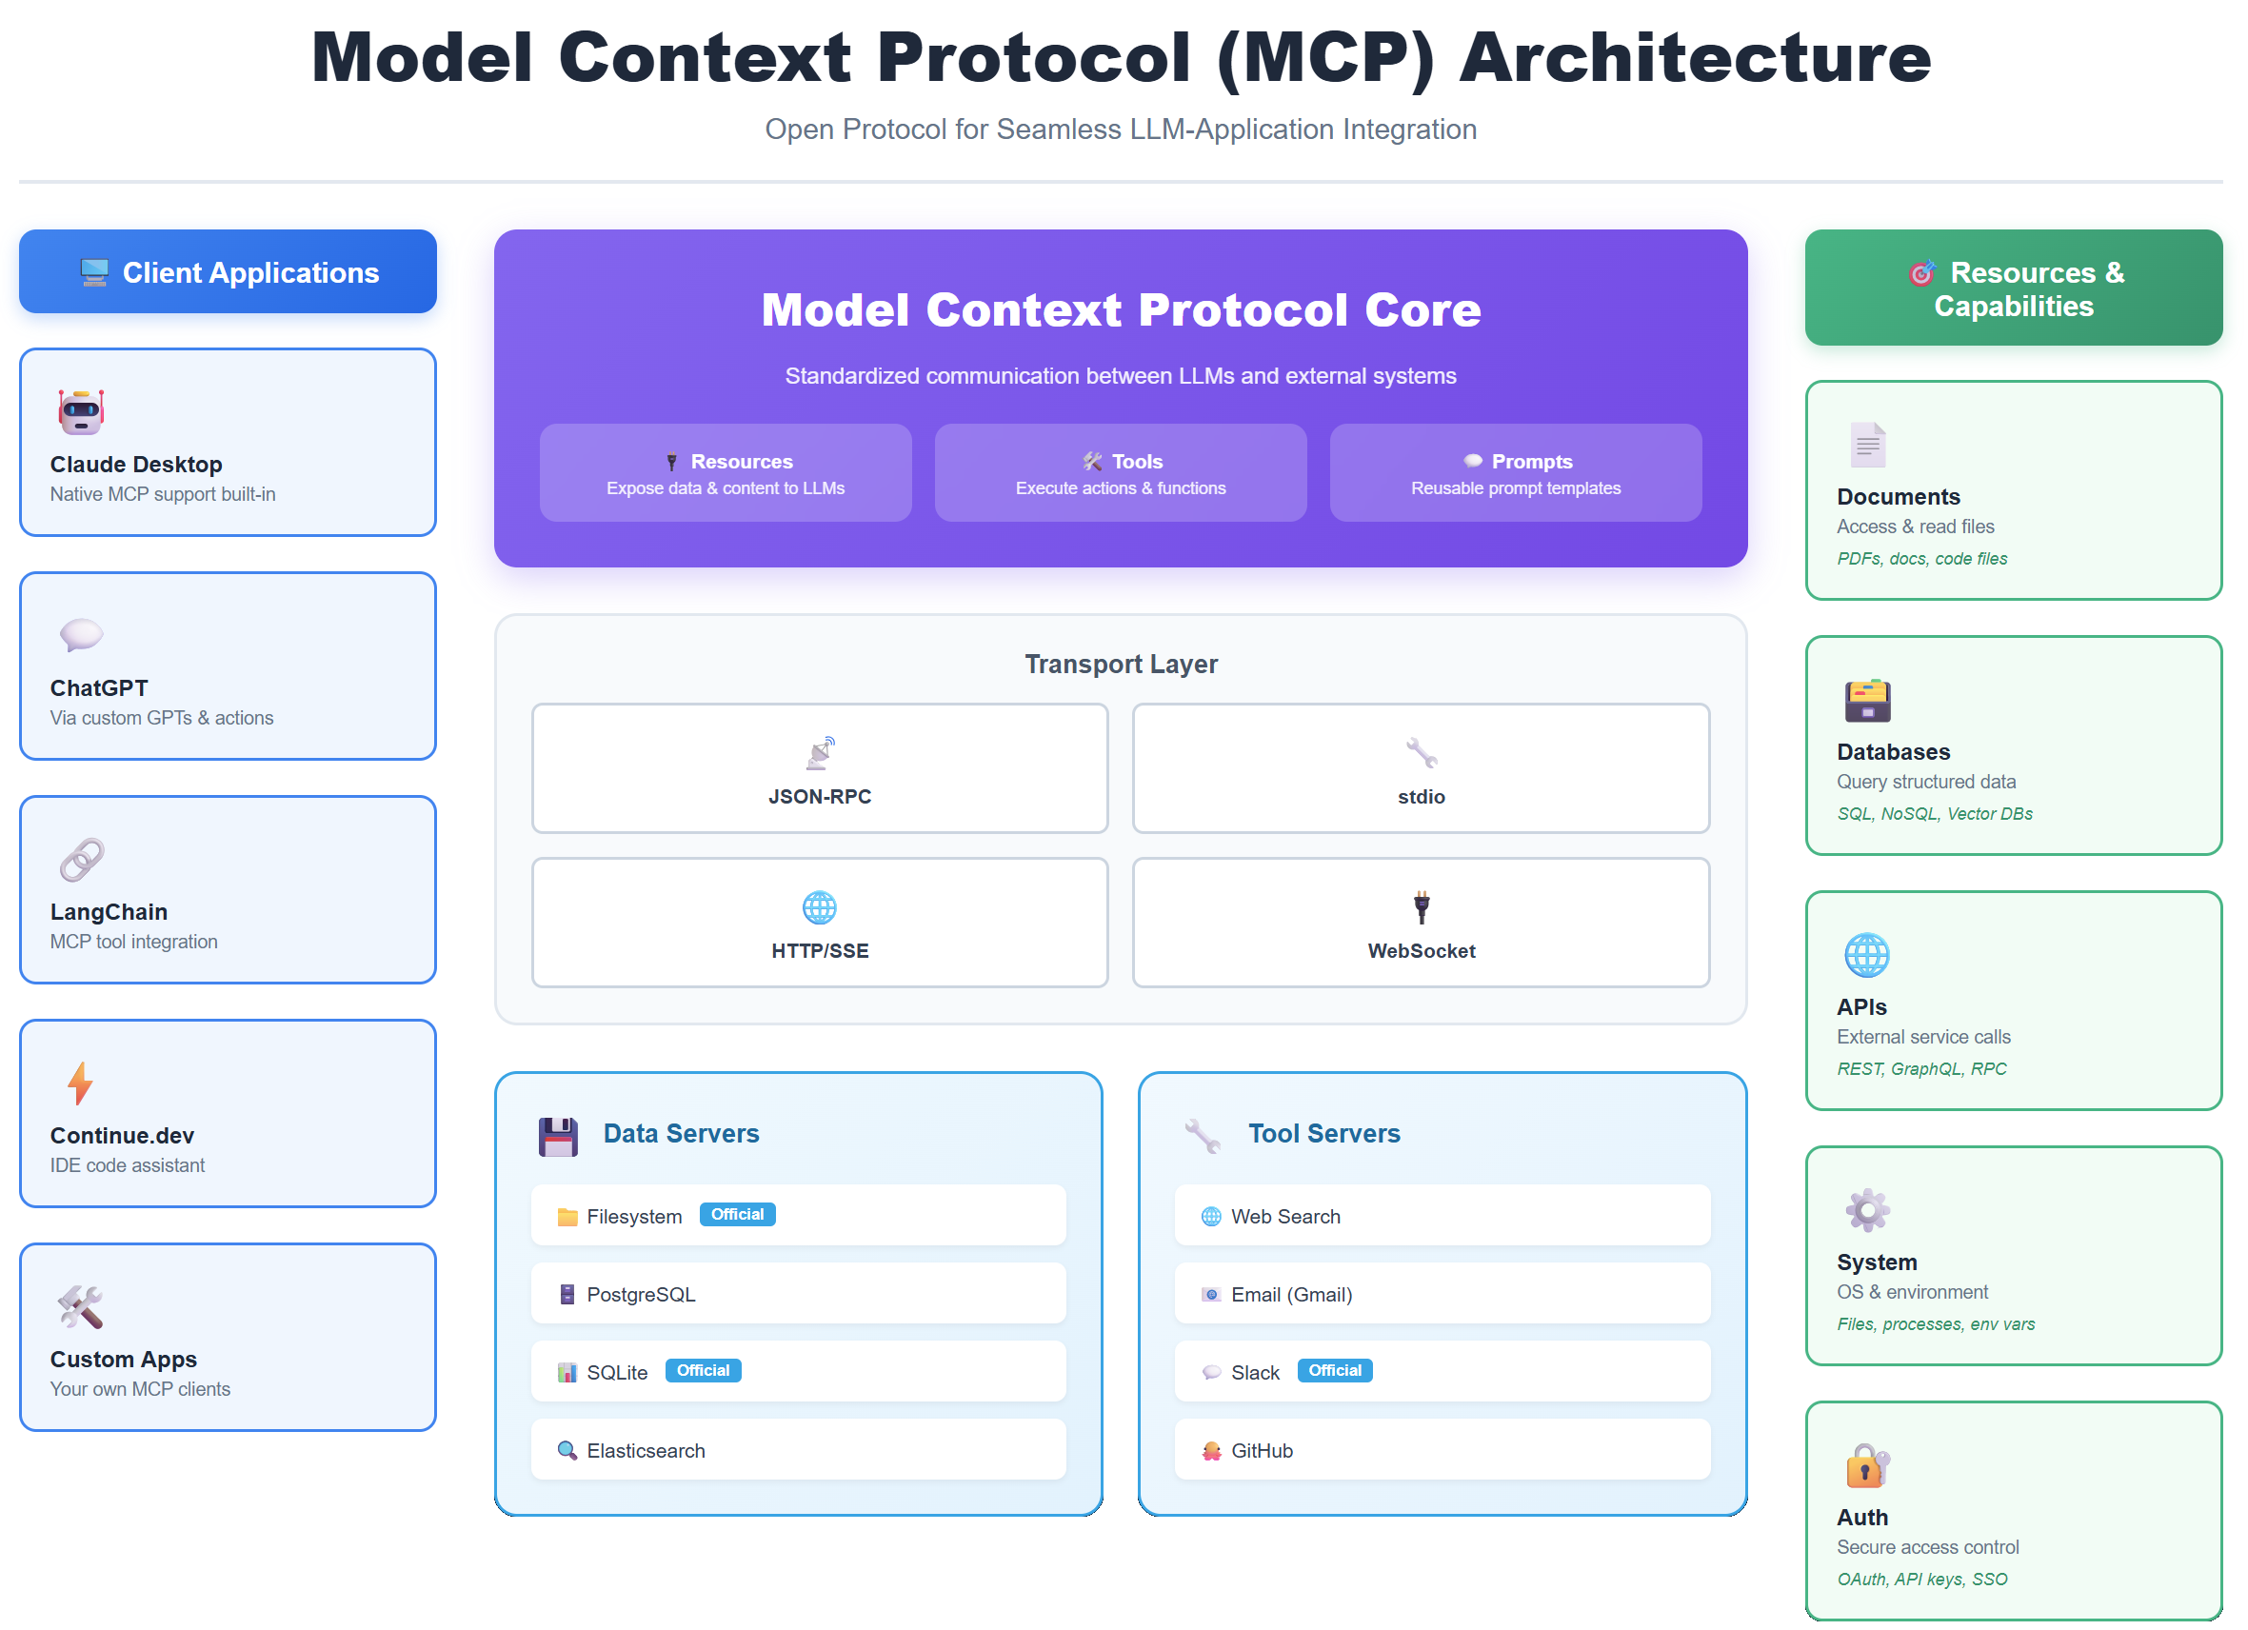

Slide 16
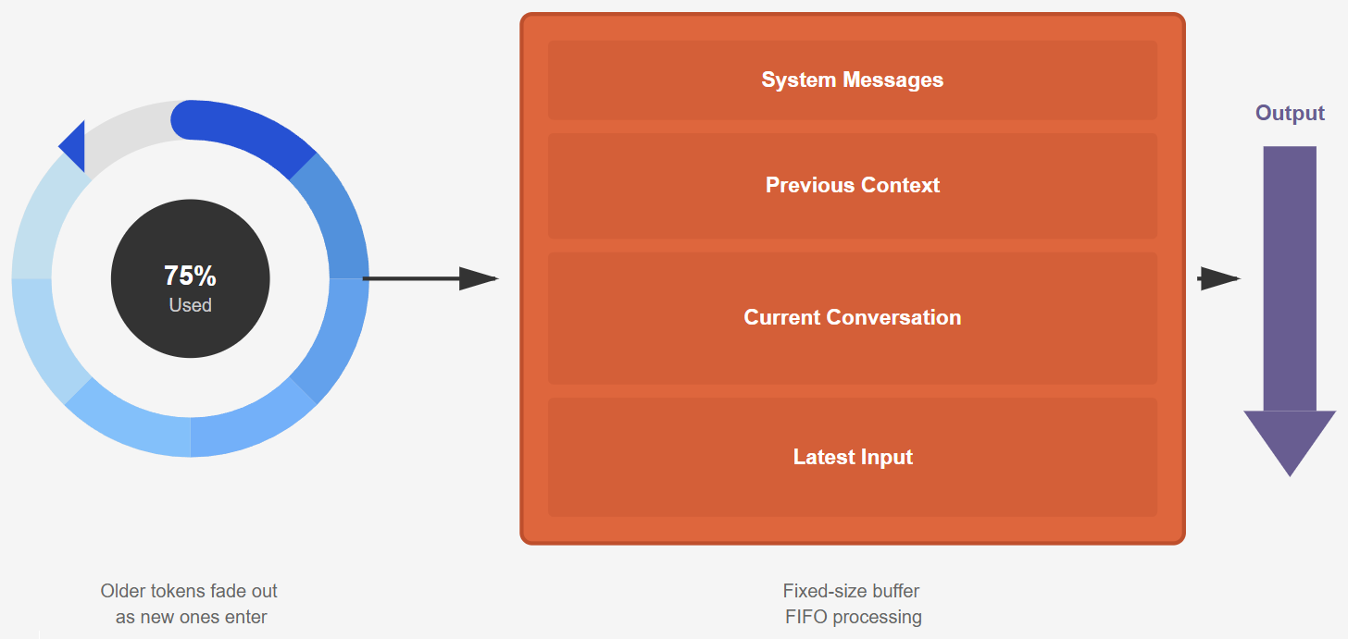
Context Window
Notes:
Illustration credit: Tim

Slide 17
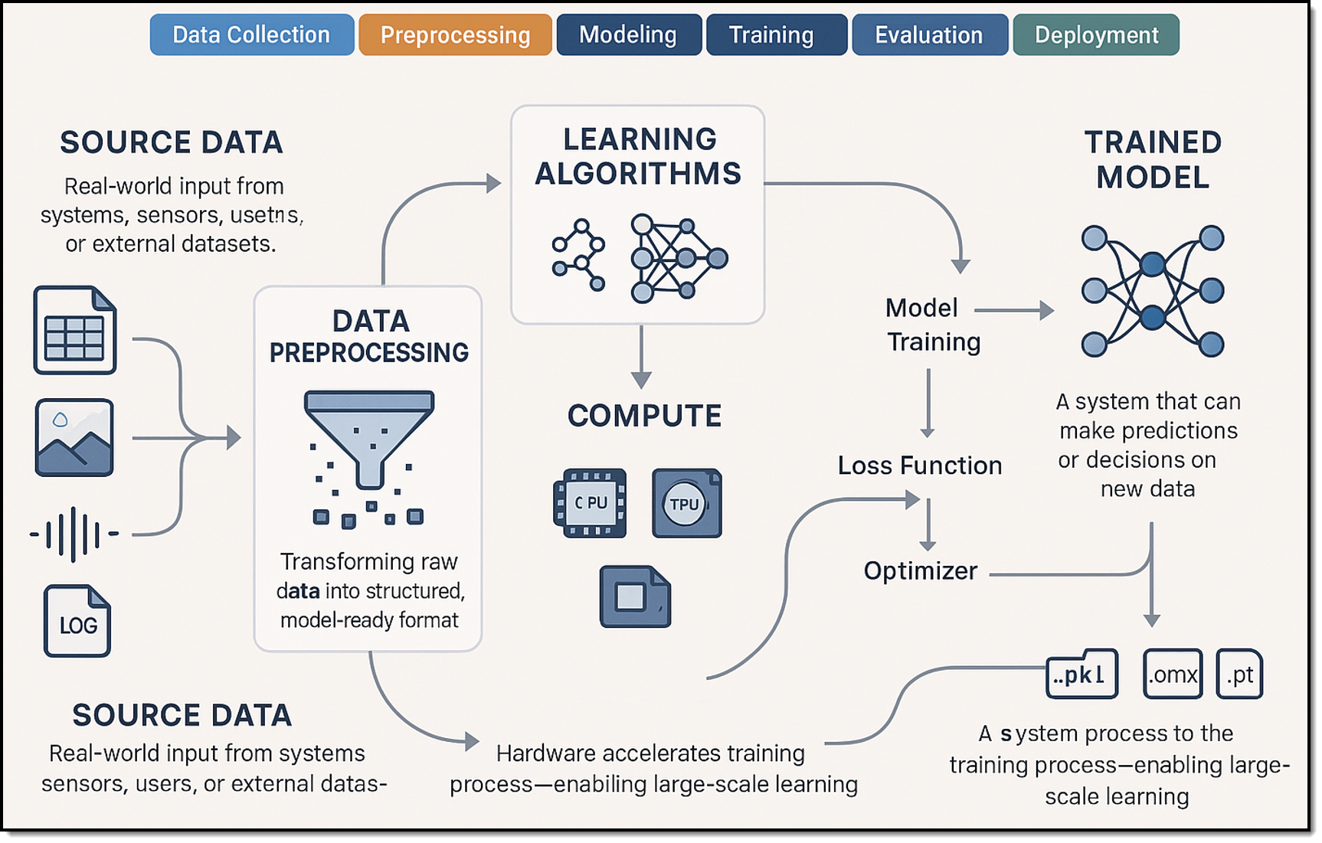
Machine Learning (ML) lifecycle
Notes:
I generated the image with my prompt in my personal ChatGPT account using their latest image-gen model. Did that on Wed, 3/26/2025 at 3pm Central or thereabouts.

Slide 18
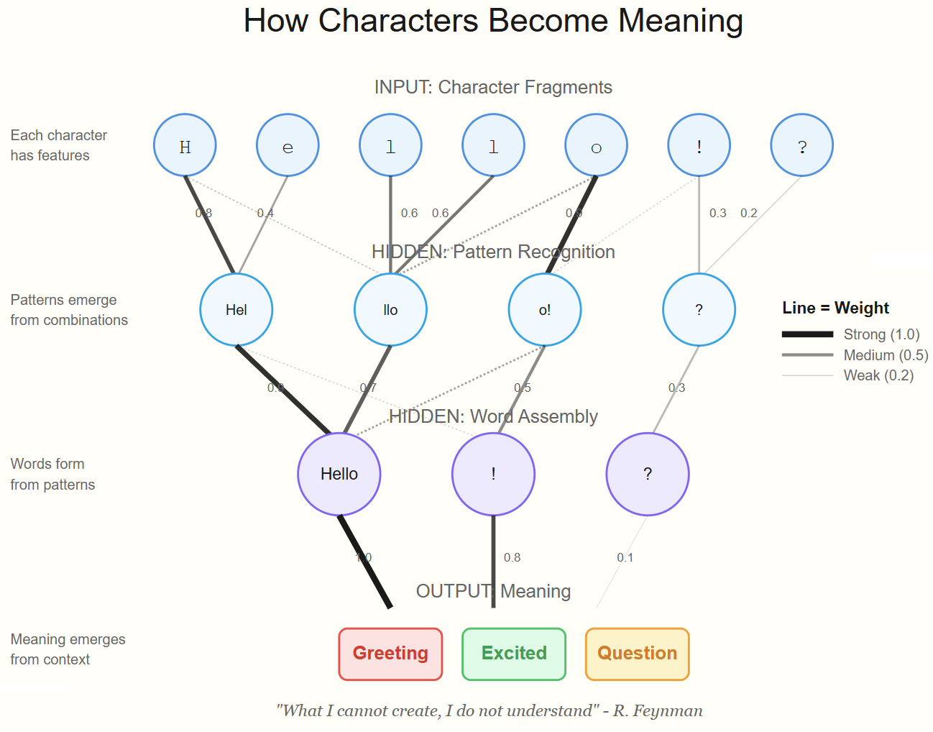
Neural Network
Notes:
Image credit: Tim + Claude AI

Slide 19

Neural Network
go.techtrainertim.com/cloud

Slide 20
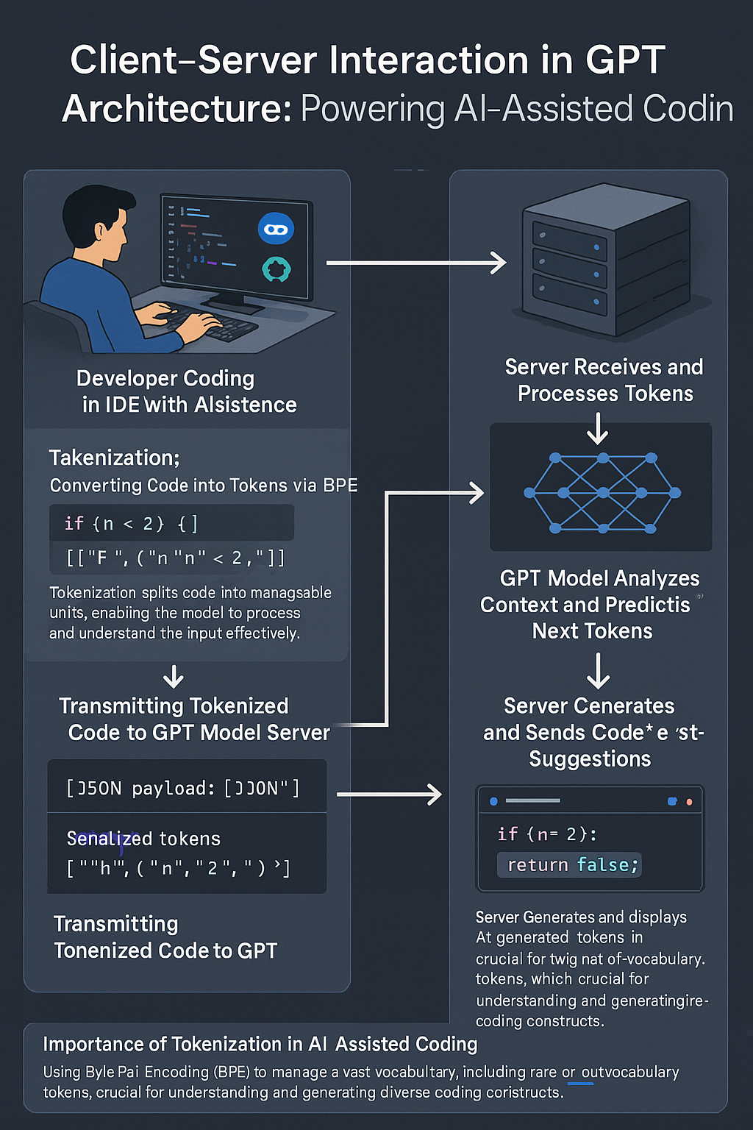
GPT Basic Architecture
OpenAI GPT 4o Image Generation
Multimodal generative AI
Two ways to improve model:
Fine tuning
Retrieval Augmented Generation (RAG)

Slide 21
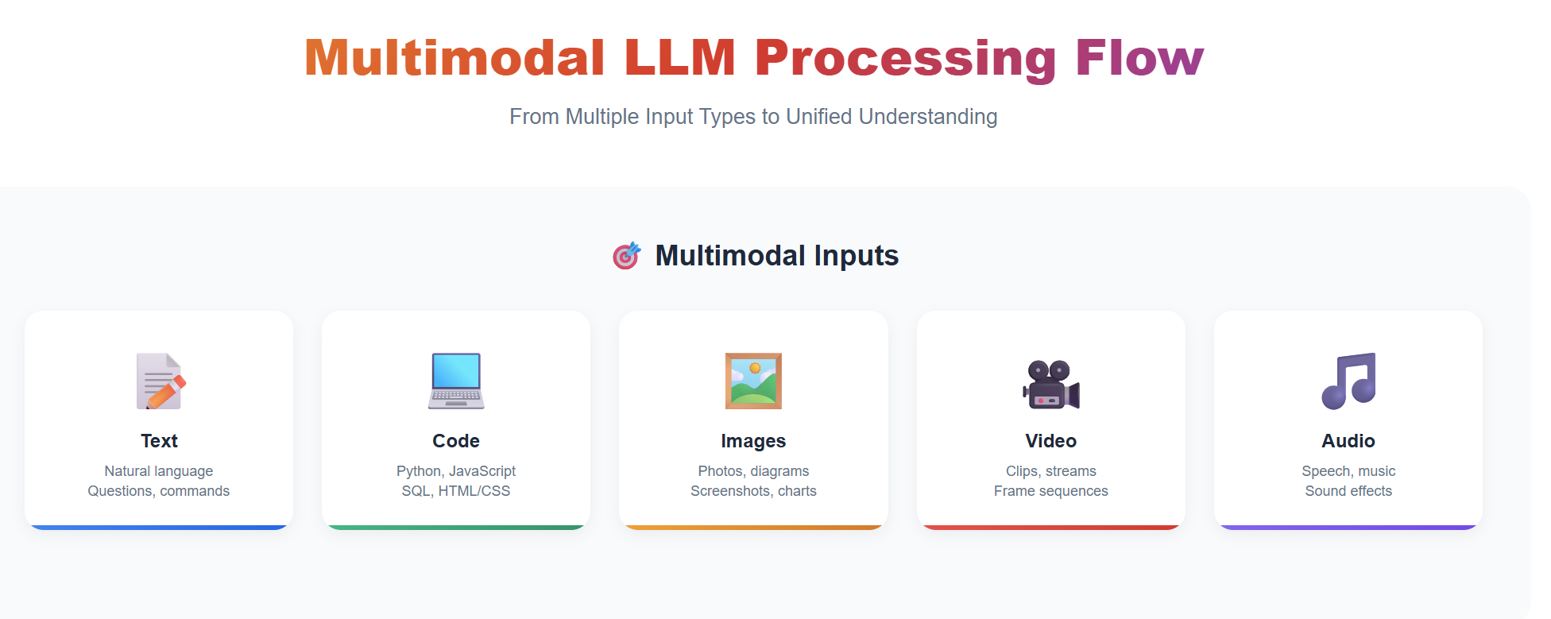
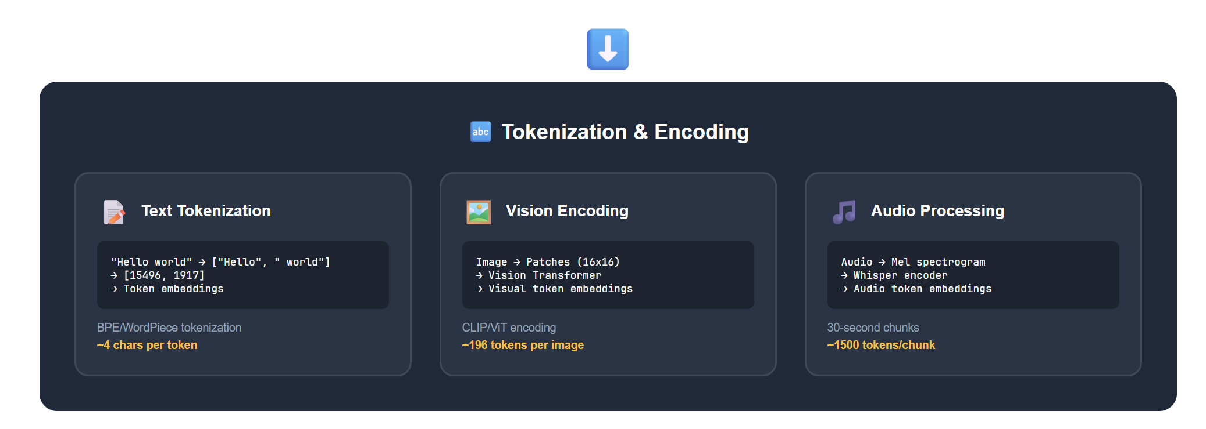
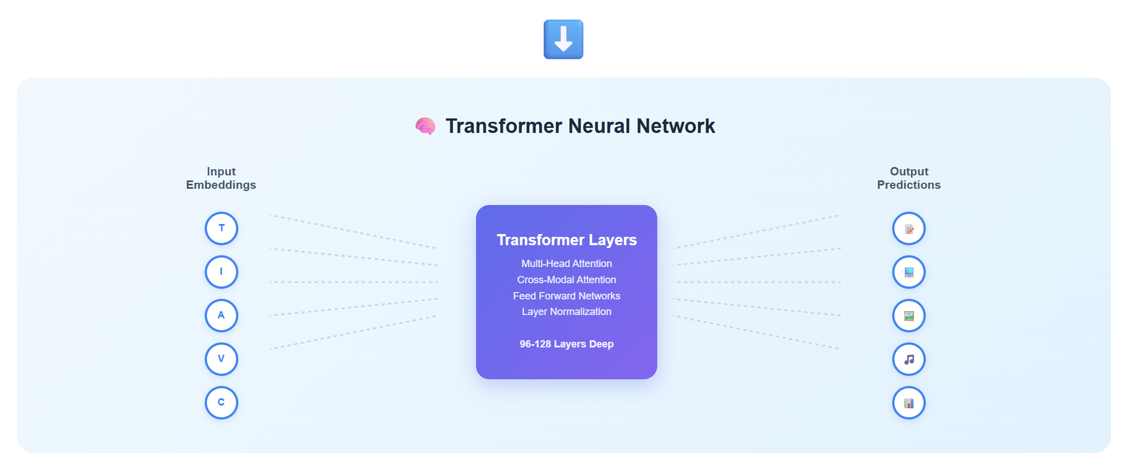
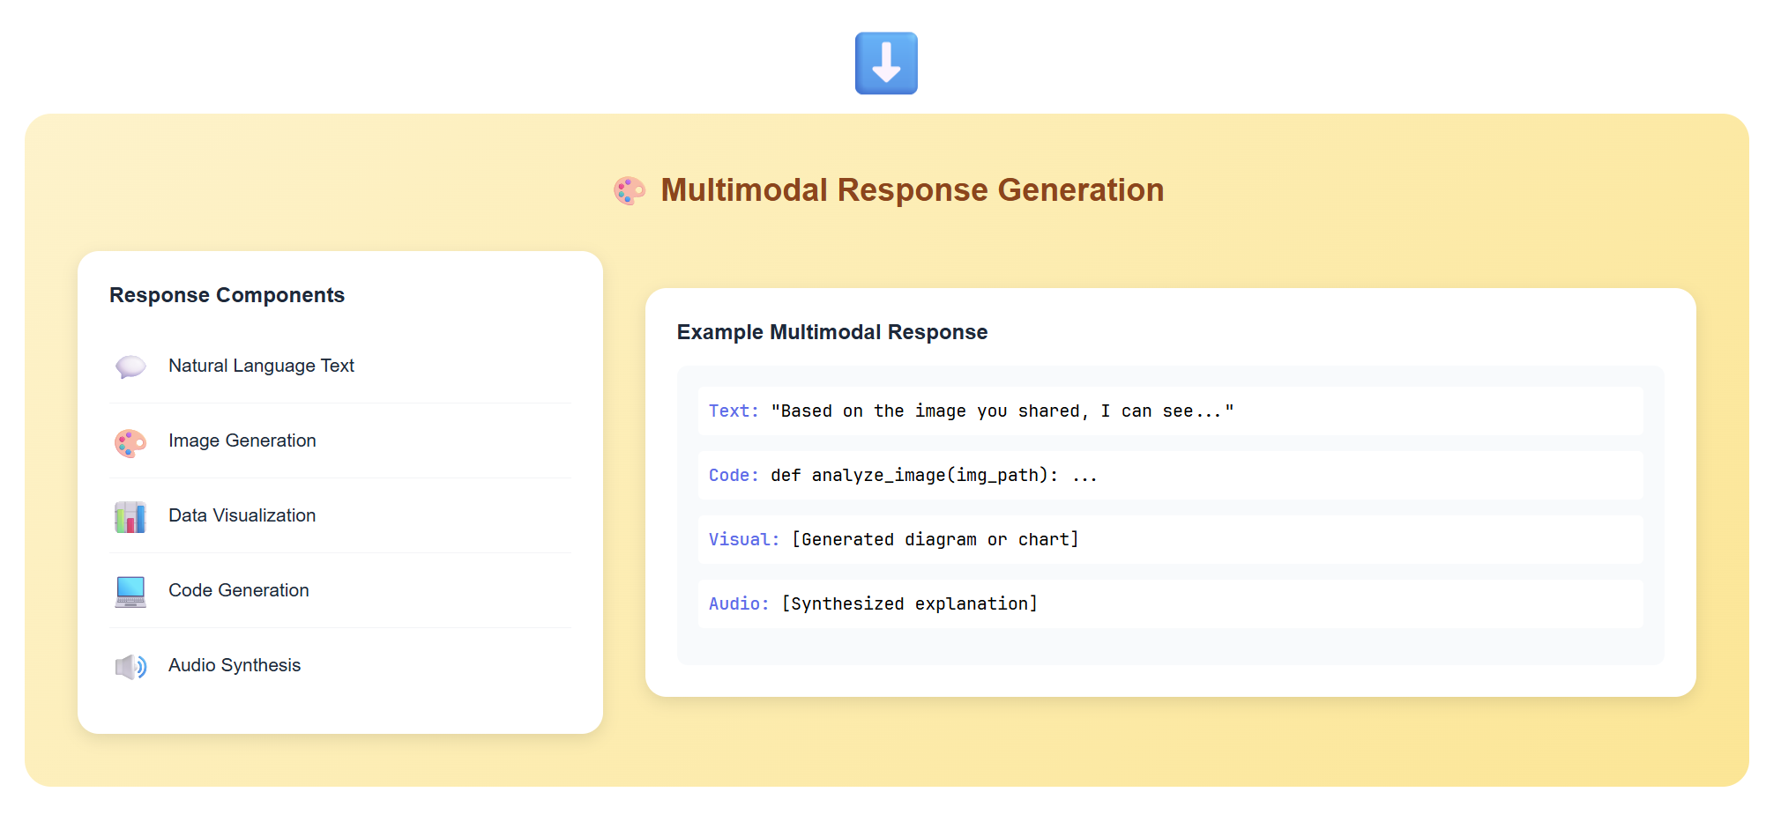

Slide 22
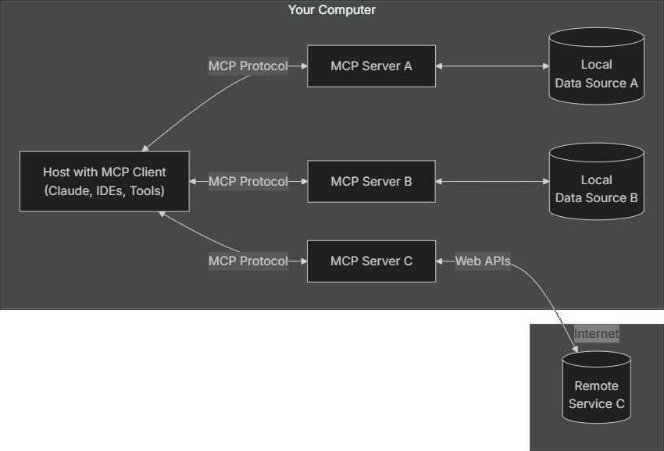
Anthropic Model Context Protocol (MCP)
modelcontextprotocol.io

Slide 23
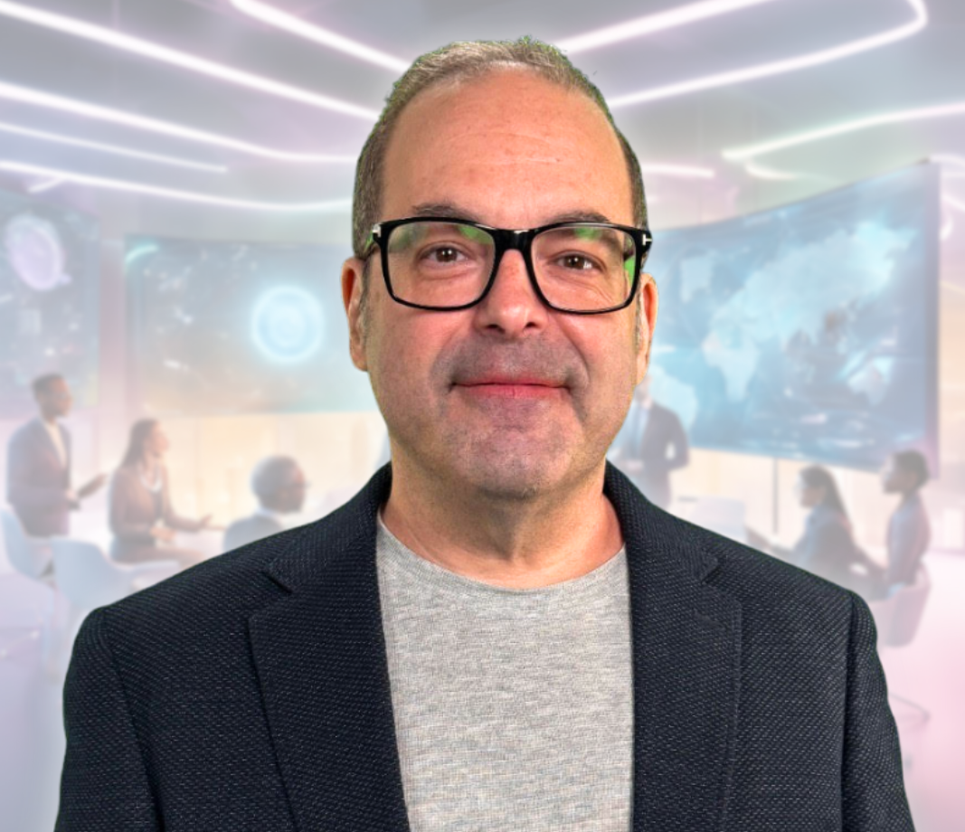
Thank You for Attending!
Please don’t forget to complete the O’Reilly course evaluation
Session materials: github.com/timothywarner-org/agents-pro
Web: techtrainertim.com

